Slide 1

Supply Chain Management: Strategy, Planning, and Operation
Seventh Edition
Chapter 7
Demand Forecasting in a Supply Chain
Copyright © 2019, 2016, 2013 Pearson Education, Inc. All Rights Reserved
Notes:
If this PowerPoint presentation contains mathematical equations, you may need to check that your computer has the following installed:
1) MathType Plugin
2) Math Player (free versions available)
3) NVDA Reader (free versions available)

Slide 2
Learning Objectives
7.1 Understand the role of forecasting for both an enterprise and a supply chain.
7.2 Identify the components of a demand forecast and some basic approaches to forecasting.
7.3 Forecast demand using time-series methodologies given historical demand data in a supply chain.
7.4 Analyze demand forecasts to estimate forecast error.
7.5 Use Excel to build time-series forecasting models.

Slide 3
Role of Forecasting in a Supply Chain
The basis for all planning decisions in a supply chain
Used for both push and pull processes
Production scheduling, inventory, aggregate planning
Sales force allocation, promotions, new production introduction
Plant/equipment investment, budgetary planning
Workforce planning, hiring, layoffs
All of these decisions are interrelated

Slide 4
Characteristics of Forecasts
Forecasts are always inaccurate and should thus include both the expected value of the forecast and a measure of forecast error
Long-term forecasts are usually less accurate than short-term forecasts
Aggregate forecasts are usually more accurate than disaggregate forecasts
In general, the farther up the supply chain a company is, the greater is the distortion of information it receives

Slide 5
Summary of Learning Objective 1 (1 of 2)
Forecasting is a key input for virtually every design and planning decision made in a supply chain. It is important to recognize that all forecasts are likely to be wrong. Thus, an estimation of forecast error is essential to effectively use the forecast. Reducing the forecast horizon (by reducing the lead time of the associated decision) and aggregation are two effective approaches to decrease forecast error.

Slide 6
Summary of Learning Objective 1 (2 of 2)
A relatively recent phenomenon, however, is to create collaborative forecasts for an entire supply chain and use these as the basis for decisions. Collaborative forecasting greatly increases the accuracy of forecasts and allows the supply chain to maximize its performance. Without collaboration, supply chain stages farther from demand will likely have poor forecasts that will lead to supply chain inefficiencies and a lack of responsiveness.

Slide 7
Components and Methods (1 of 2)
Companies must identify the factors that influence future demand and then ascertain the relationship between these factors and future demand
Past demand
Lead time of product replenishment
Planned advertising or marketing efforts
Planned price discounts
State of the economy
Actions that competitors have taken

Slide 8
Components and Methods (2 of 2)
Qualitative
Primarily subjective
Rely on judgment
Time Series
Use historical demand only
Best with stable demand
Causal
Relationship between demand and some other factor
Simulation
Imitate consumer choices that give rise to demand

Slide 9
Components of An Observation
Observed demand (O) = systematic component (S)
+ random component (R)
Systematic component – expected value of demand
Level (current deseasonalized demand)
Trend (growth or decline in demand)
Seasonality (predictable seasonal fluctuation)
Random component – part of forecast that deviates from systematic part
Forecast error – difference between forecast and actual demand

Slide 10
Five Important Points in the Forecasting Process
Understand the objective of forecasting.
Integrate demand planning and forecasting throughout the supply chain.
Identify the major factors that influence the demand forecast.
Forecast at the appropriate level of aggregation.
Establish performance and error measures for the forecast.

Slide 11
Summary of Learning Objective 2
Demand consists of a systematic and a random component. The systematic component measures the expected value of demand. The random component measures fluctuations in demand from the expected value. The systematic component consists of level, trend, and seasonality. Level measures the current de-seasonalized demand. Trend measures the current rate of growth or decline in demand. Seasonality indicates predictable seasonal fluctuations in demand. The goal of forecasting is to estimate the systematic component and the size (not direction) of the random component (in the form of a forecast error). Good forecasting requires a clear understanding of the objective of the forecast and should be integrated across the supply chain.

Slide 12
Time-Series Forecasting Methods
Three ways to calculate the systematic component
Multiplicative
S = level × trend × seasonal factor
Additive
S = level + trend + seasonal factor
Mixed
S = (level + trend) × seasonal factor

Slide 13
Static Methods
Systematic component = (level+trend)×seasonal factor
Where
L = estimate of level at t = 0
T = estimate of trend
S_{t} = estimate of seasonal factor for Period t
D_{t} = actual demand observed in Period t
F_{t} = forecast of demand for Period t

Slide 14
Tahoe Salt (1 of 5)
Table 7-1 Quarterly Demand for Tahoe Salt
Year | Quarter | Period, t | Demand, D_{t}
1 | 2 | 1 | 8,000
1 | 3 | 2 | 13,000
1 | 4 | 3 | 23,000
2 | 1 | 4 | 34,000
2 | 2 | 5 | 10,000
2 | 3 | 6 | 18,000
2 | 4 | 7 | 23,000

Slide 15
Tahoe Salt (2 of 5)
Table 7-1 [continued]
Year | Quarter | Period, t | Demand, D_{t}
3 | 1 | 8 | 38,000
3 | 2 | 9 | 12,000
3 | 3 | 10 | 13,000
3 | 4 | 11 | 32,000
4 | 1 | 12 | 41,000

Slide 16
Tahoe Salt (3 of 5)
Figure 7-1 Quarterly Demand at Tahoe Salt
Deseasonalize demand and run linear regression to estimate level and trend.
Estimate seasonal factors.

Slide 17
Estimate Level and Trend (1 of 2)
Periodicity p = 4, t = 3

Slide 18
Estimate Level and Trend (2 of 2)

Slide 19
Tahoe Salt (4 of 5)
Figure 7-2 Excel Workbook with Deseasonalized Demand for Tahoe Salt

Slide 20
Tahoe Salt (5 of 5)
Figure 7-3 Deseasonalized Demand for Tahoe Salt
A linear relationship exists between the deseasonalized demand and time based on the change in demand over time

Slide 21
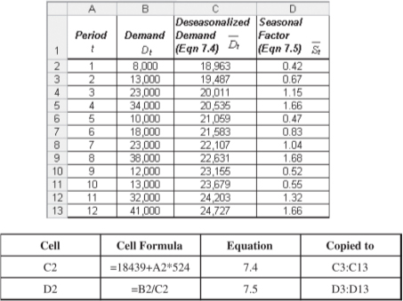
Estimating Seasonal Factors (1 of 3)
Figure 7-4 Deseasonalized Demand and Seasonal Factors for Tahoe Salt

Slide 22
Estimating Seasonal Factors (2 of 3)

Slide 23
Estimating Seasonal Factors (3 of 3)

Slide 24
Adaptive Forecasting (1 of 2)
The estimates of level, trend, and seasonality are updated after each demand observation
Estimates incorporate all new data that are observed

Slide 25
Adaptive Forecasting (2 of 2)
Where
L_{t} = estimate of level at the end of Period t
T_{t} = estimate of trend at the end of Period t
S_{t} = estimate of seasonal factor for Period t
F_{t} = forecast of demand for Period t (made Period t – 1 or earlier)
D_{t} = actual demand observed in Period t
E_{t} = F_{t} – D_{t} = forecast error in Period t

Slide 26
Steps in Adaptive Forecasting
Initialize
Compute initial estimates of level (L₀), trend (T₀), and seasonal factors (S₁,…,S_{p})
Forecast
Forecast demand for period t + 1
Estimate error
Compute error E_{t+1} = F_{t+1} – D_{t+1}
Modify estimates
Modify the estimates of level (L_{t+1}), trend (T_{t+1}), and seasonal factor (S_{t+p+1}), given the error E_{t+1}

Slide 27
Moving Average
Used when demand has no observable trend or seasonality
Systematic component of demand = level
The level in period t is the average demand over the last N periods
After observing the demand for period t + 1, revise the estimates

Slide 28
Moving Average Example (1 of 2)
A supermarket has experienced weekly demand of milk of D1 = 120, D2 = 127, D3 = 114, and D4 = 122 gallons over the past four weeks
Forecast demand for Period 5 using a four-period moving average
What is the forecast error if demand in Period 5 turns out to be 125 gallons?

Slide 29
Moving Average Example (2 of 2)
Forecast demand for Period 5
F₅ = L₄ = 120.75 gallons
Error if demand in Period 5 = 125 gallons
E₅ = F₅ – D₅ = 120.75 – 125 = – 4.25
Revised demand

Slide 30
Simple Exponential Smoothing (1 of 3)
Used when demand has no observable trend or seasonality
Systematic component of demand = level
Initial estimate of level, L₀, assumed to be the average of all historical data

Slide 31
Simple Exponential Smoothing (2 of 3)
Given data for Periods 1 to n
Current forecast
Revised forecast using smoothing constant (0 < α < 1)
Thus

Slide 32
Simple Exponential Smoothing (3 of 3)
Supermarket data
F₁ = L₀ = 120.75
E₁ = F₁−D₁ = 120.75−120 = 0.75
L₁ = αD₁+(1−α)L₀
= 0.1×120+0.9 ×120.75=120.68

Slide 33
Trend-Corrected Exponential Smoothing (Holt’s Model) (1 of 4)
Appropriate when the demand is assumed to have a level and trend in the systematic component of demand but no seasonality
Systematic component of demand = level + trend

Slide 34
Trend-Corrected Exponential Smoothing (Holt’s Model) (2 of 4)
Obtain initial estimate of level and trend by running a linear regression
D_{t} = at + b
T₀ = a, L₀ = b
In Period t, the forecast for future periods is
F_{t+1} = L_{t} + T_{t} and F_{t+n} = L_{t} + nT_{t}
Revised estimates for Period t

Slide 35
Trend-Corrected Exponential Smoothing (Holt’s Model) (3 of 4)
Smartphone player demand
D1 = 8,415, D2 = 8,732, D3 = 9,014, D4 = 9,808,D5 = 10,413, D6 = 11,961, α = 0.1, β = 0.2
Using regression analysis
L₀ = 7,367 and T₀ = 673
Forecast for Period 1
F₁ = L₀ + T₀ = 7,367 + 673 = 8,040
Period 1 error
E₁ = F₁ – D₁ = 8,040 – 8,415 = –375

Slide 36
Trend-Corrected Exponential Smoothing (Holt’s Model) (4 of 4)
Revised estimate
With new L₁
F₂ = L₁ + T₁ = 8,078 + 681 = 8,759
Continuing
F₇ = L₆ + T₆ = 11,399 + 673 = 12,072

Slide 37
Trend- and Seasonality-Corrected Exponential Smoothing (1 of 2)
Appropriate when the systematic component of demand has a level, trend, and seasonal factor
Systematic component = (level + trend) × seasonal factor

Slide 38
Trend- and Seasonality-Corrected Exponential Smoothing (2 of 2)
After observing demand for period t + 1, revise estimates for level, trend, and seasonal factors
α = smoothing constant for level
β = smoothing constant for trend
γ = smoothing constant for seasonal factor

Slide 39
Winter’s Model (1 of 3)
L₀ = 18,439 T₀ = 524
S₁= 0.47, S₂ = 0.68, S₃ = 1.17, S₄ = 1.67
F₁ = (L₀ + T₀)S₁ = (18,439 + 524)(0.47) = 8,913
The observed demand for Period 1 = D₁ = 8,000
Forecast error for Period 1
= E₁ = F₁ – D1
= 8,913 – 8,000 = 913

Slide 40
Winter’s Model (2 of 3)
Assume α = 0.1, β = 0.2, γ = 0.1; revise estimates for level and trend for period 1 and for seasonal factor for Period 5

Slide 41
Winter’s Model (3 of 3)
Forecast demand for Period 2
F₂ = (L₁ + T₁)S₂ = (18,769 + 485)(0.68) = 13,093

Slide 42
Time Series Models
Forecasting Method | Applicability
Moving average | No trend or seasonality
Simple exponential smoothing | No trend or seasonality
Holt’s model | Trend but no seasonality
Winter’s model | Trend and seasonality

Slide 43
Summary of Learning Objective 3
Time-series methods for forecasting are categorized as static or adaptive. In static methods, the estimates of parameters are not updated as new demand is observed. Static methods include regression. In adaptive methods, the estimates are updated each time a new demand is observed. Adaptive methods include moving averages, simple exponential smoothing, Holt’s model, and Winter’s model. Moving averages and simple exponential smoothing are best used when demand displays neither trend nor seasonality. Holt’s model is best when demand displays a trend but no seasonality. Winter’s model is appropriate when demand displays both trend and seasonality.

Slide 44
Measures of Forecast Error (1 of 2)
Forecast errors contain valuable information and must be analyzed for two reasons:
Managers use error analysis to determine whether the current forecasting method is predicting the systematic component of demand accurately
All contingency plans must account for forecast error

Slide 45
Measures of Forecast Error (2 of 2)

Slide 46
Summary of Learning Objective 4
Forecast error measures the random component of demand. This measure is important because it reveals how inaccurate a forecast is likely to be and what contingencies a firm may have to plan for. The M S E, M A D, and M A P E are used to estimate the size of the fore- cast error. The bias and T S are used to estimate if the forecast consistently over- or under- forecasts or if demand has deviated significantly from historical norms.

Slide 47
Selecting the Best Smoothing Constant (1 of 2)
Figure 7-5 Selecting Smoothing Constant by Minimizing M S E

Slide 48
Selecting the Best Smoothing Constant (2 of 2)
Figure 7-6 Selecting Smoothing Constant by Minimizing M A D

Slide 49
Forecasting Demand at Tahoe Salt (1 of 10)
Moving average
Simple exponential smoothing
Trend-corrected exponential smoothing
Trend- and seasonality-corrected exponential smoothing

Slide 50
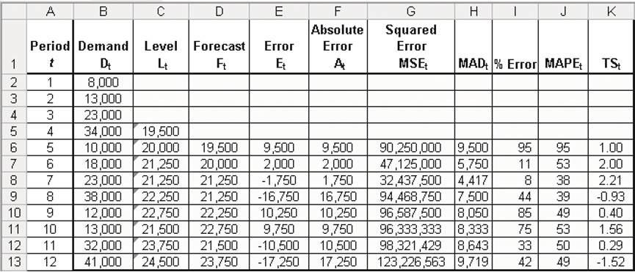
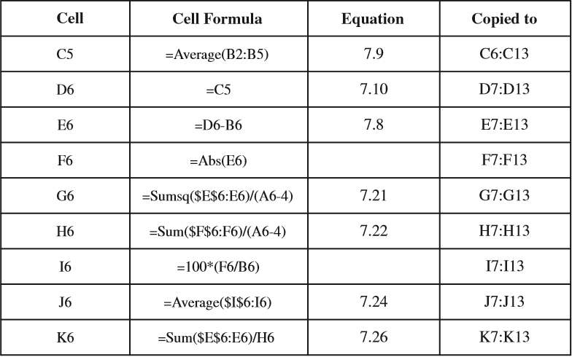
Forecasting Demand at Tahoe Salt (2 of 10)
Figure 7-7 Tahoe Salt Forecasts Using Four-Period Moving Average

Slide 51
Forecasting Demand at Tahoe Salt (3 of 10)
Moving average
L₁₂ = 24,500
F₁₃ = F₁₄ = F₁₅ = F₁₆ = L₁₂ = 24,500
σ = 1.25 × 9,719 = 12,148

Slide 52
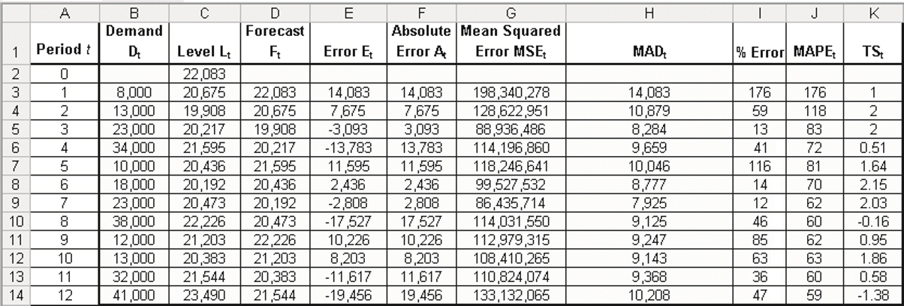
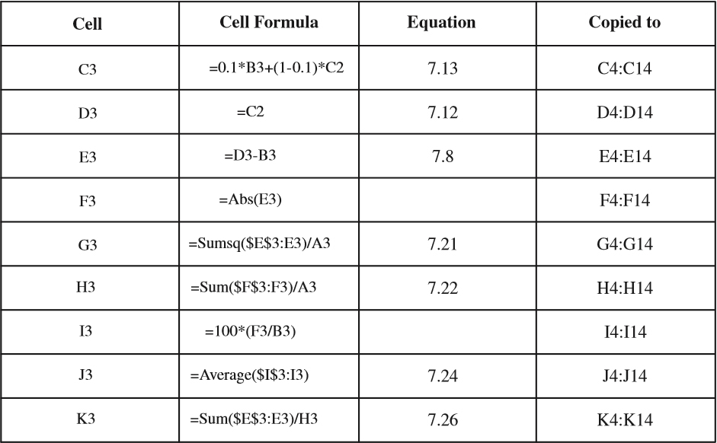
Forecasting Demand at Tahoe Salt (4 of 10)
Figure 7-8 Tahoe Salt Forecasts Using Simple Exponential Smoothing

Slide 53
Forecasting Demand at Tahoe Salt (5 of 10)
Simple exponential smoothing
α = 0.1
L₀ = 22,083
L₁₂ = 23,490
F₁₃ = F₁₄ = F₁₅ = F₁₆ = L₁₂ = 23,490
σ = 1.25 × 10,208 = 12,761

Slide 54
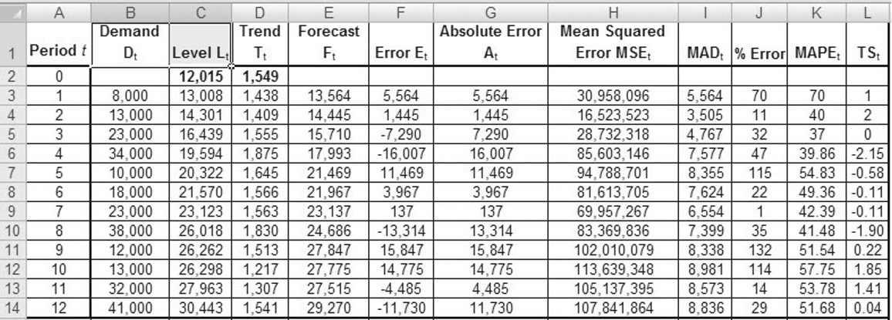
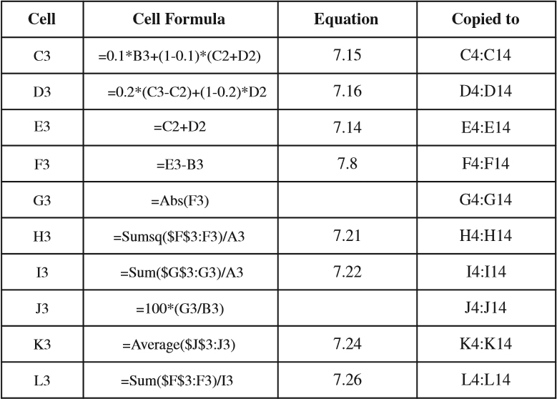
Forecasting Demand at Tahoe Salt (6 of 10)
Figure 7-9 Trend-Corrected Exponential Smoothing

Slide 55
Forecasting Demand at Tahoe Salt (7 of 10)
Trend-Corrected Exponential Smoothing
L₀ = 12,015 and T₀ = 1,549
L₁₂ = 30,443 and T₁₂ = 1,541
F₁₃ = L₁₂ + T₁₂ = 30,443 + 1,541 = 31,984
F₁₄ = L₁₂ + 2T₁₂ = 30,443 + 2 × 1,541 = 33,525
F₁₅ = L₁₂ + 3T₁₂ = 30,443 + 3 × 1,541 = 35,066
F₁₆ = L₁₂ + 4T₁₂ = 30,443 + 4 × 1,541 = 36,607
σ = 1.25 × 8,836 = 11,045

Slide 56
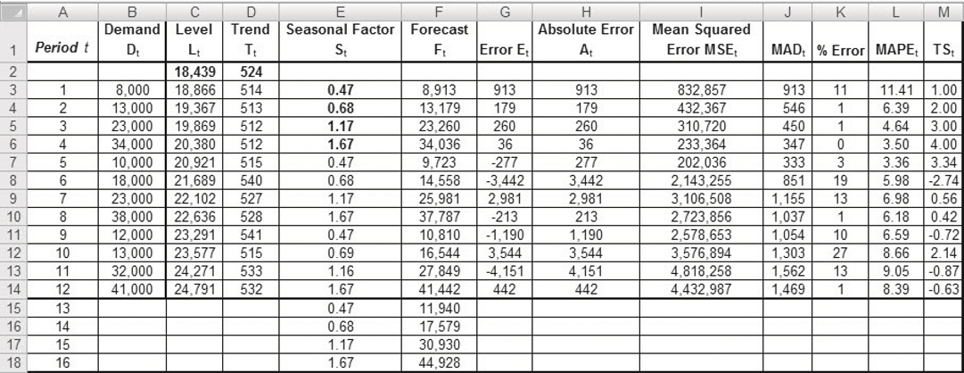
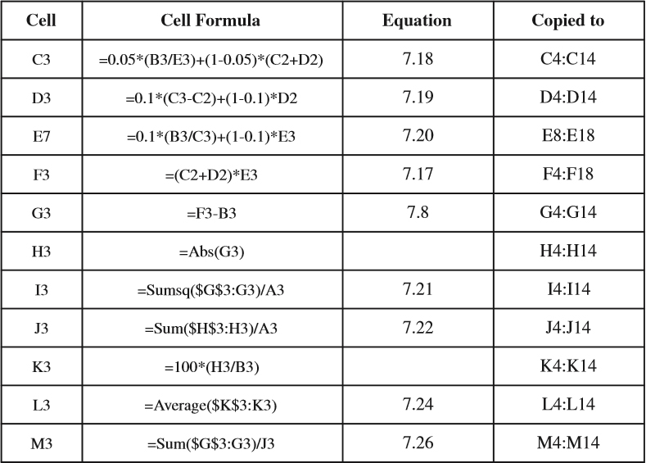
Forecasting Demand at Tahoe Salt (8 of 10)
Figure 7-10 Trend- and Seasonality-Corrected Exponential Smoothing

Slide 57
Forecasting Demand at Tahoe Salt (9 of 10)
Trend- and Seasonality-Corrected
L₀ = 18,439 T₀ =524
L₁₂ = 24,791 T₁₂ = 532
S₁ = 0.47 S₂ = 0.68 S₃ = 1.17 S₄ = 1.67
F₁₃ = (L₁₂ + T₁₂)S₁₃ = (24,791 + 532)0.47 = 11,902
F₁₄ = (L₁₂ + 2T₁₂)S₁₃ = (24,791 + 2 × 532)0.68 = 17,581
F₁₅ = (L₁₂ + 3T₁₂)S₁₃ = (24,791 + 3 × 532)1.17 = 30,873
F₁₆ = (L₁₂ + 4T₁₂)S₁₃ = (24,791 + 4 × 532)1.67 = 44,955
σ = 1.25 × 1,469 = 1,836

Slide 58
Forecasting Demand at Tahoe Salt (10 of 10)
Table 7-2 Error Estimates for Tahoe Salt Forecasting
Forecasting Method | M A D | M A P E (%) | T S Range
Four-period moving average | 9,719 | 49 | –1.52 to 2.21
Simple exponential smoothing | 10,208 | 59 | –1.38 to 2.15
Holt’s model | 8,836 | 52 | –2.15 to 2.00
Winter’s model | 1,469 | 8 | –2.74 to 4.00

Slide 59
The Role of Software Tools in Forecasting
Software is important
Large amounts of data
Frequency of forecasts
Importance of high-quality results
Can forecast demand by products and markets
Real time updates help firms respond quickly to changes in marketplace
Facilitates demand planning

Slide 60
Summary of Learning Objective 5
Given the repetitive nature of time-series forecasting methods, they can easily be modeled in Microsoft Excel with simple formulae that are copied across rows or columns. For regular forecasting at companies, however, it may be more effective to select among a wide variety of software packages available today.

Slide 61

Copyright

